Slide 1
Lecture 0
Computer Simulation
Prof. Dr.Abbas H. Hassin Alasadi
Computer Information System
Computer Science and Information Technology
Basrah University
Email: abbashh2002@gmail.com

Slide 2
Course Overview
This course is designed for graduate students in any of the following degrees:
Computer Science
Telecommunication Engineering
Business Management
Industrial Engineering
Economics
Mathematics
Physics.
Background course is required:
mathematical
probability and statistics
some programming skills (e.g.: Java or C++)

Slide 3
The Main Goals
Offers a set of powerful system modeling and analysis tools (concepts, techniques and skills) that students can use both in their research and professional careers.
To develop students’ modeling, analytical-thinking and synthesis skills.
In particular, during the course students will have to: model systems or processes in order to analyze them, read research papers and develop their own scientific articles.

Slide 4
Course Objective
Apply scientific thinking to the analysis of complex systems and processes.
Comprehend important concepts in computer modeling and simulation.
Form a hypothesis and design a computer experiment to test it.
Collect and model data.
Understand how computers generate (pseudo-) random numbers and varieties.
Realize the application scope and limitations of computer simulation techniques.
Construct, verify and validate system and processes models.

Slide 5
Course Reference
DISCRETE-EVENT SYSTEM SIMULATION
Fifth Edition
Jerry Banks • John S. Carson II
Barry L. Nelson • David M. Nicol

Slide 6
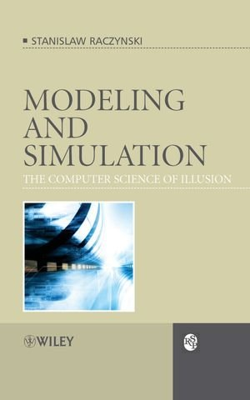
Course Reference
Modeling and Simulation: The Computer Science of Illusion
Publisher: Wiley, Year: 2006
Stanislaw Raczynski

Slide 7
Introduction
Computer Modeling and Simulation (CMS) is a hybrid discipline that combines knowledge and techniques from Operations Research and Computer Science .

Slide 8
What is Simulation
Simulation is the process of designing a model of a real system and conducting experiments with this model for the purpose either
of understanding the behavior of the system or
of evaluating various strategies for the operation of the system.
Simulation in general is to invented that one deals with a real thing while really working with an imitation.
Computer simulation is the technique of representing the real world by a computer program. It is the discipline of designing a model of an actual or theoretical physical system, executing the model on a computer, and analyzing the execution output.

Slide 9
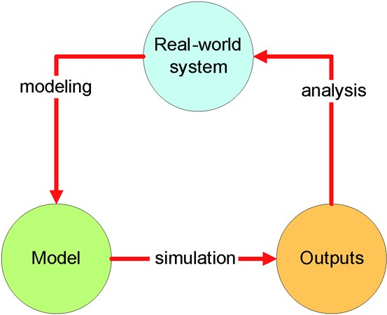
What is Simulation? Cont…

Slide 10
Process of Simulation a System

Slide 11
What is the Model?
A model construct a conceptual framework that describes a system.
The behavior of a system that evolves over time is studied by developing a simulation model.
The model takes a set of expressed assumptions:
Mathematical, logical
Symbolic relationship between the entities.

Slide 12
When to use Model
For precisely this reason, models are used in industry, commerce and military: it is very costly, dangerous and often impossible to make experiments with real systems.
Provided that models are adequate descriptions of reality (they are valid), experimenting with them can save money, suffering and even time.

Slide 13
When to use Simulations
Systems which change with time such as a gas station where cars come and go (called dynamic systems) and involve randomness (nobody can guess at exactly which time and next cars should arrive at the station) are good candidates for simulation.
Modeling complex dynamic systems analytically need too many simplifications and the emerging models may not be therefore valid.
Simulation does not require that many simplifying assumptions, making it the only tool even in absence of randomness.

Slide 14
Applications: Training a Pilot
Flight simulation is an artificial re-creation of aircraft flight and various aspects of the flight environment. This includes the equations that govern how aircraft fly, how they react to applications of their controls and other aircraft systems, and how they react to the external environment such as air density, turbulence, cloud, precipitation, etc...

Slide 15
Applications : Nursing Simulation LAB
Nursing simulation labs allow
students to learn how to
diagnose, treat, and respond
to medical conditions and
patient emergencies in a safe
and supervised environment
without any threat to human life. Using state-of -the-art computer equipment and advanced technology lifelike mannequins (تمثال عرض), the students are exposed to a variety of serious health conditions they will experience in actual clinical settings

Slide 16
Applications : Vehicles Simulations
Vehicle Simulator includes a built in scenery and vehicle design, making it much simpler for users to create and share content than ever before. Like Boat and cars, trucks etc. This kind of simulation save peoples from accidents when they’re learning how to drive.

Slide 17
Applications : Science Class
Computer based simulations offer a fun and effective way to enable students to learn by doing. Simulations can be a valuable tool in the science classroom. Computer simulations help visual learners understand problems that they would not thoroughly understand simply through reading about them or solving word problems. The sophistication and variety of computer simulations in the field of science is increasing rapidly.

Slide 18
Applications : Simulation in Mapping
Simulation in Mapping is increasing Rapidly , Engineer can learn how to build Buildings, Bridges, Slopes etc. Before Building actual things they simulate it in computer and computer equipped labs

Slide 19
Advantages of Computer Simulation
To test a system without having to create the system for real (Building real-life systems can be expensive, and take a long time)
To predict what might happen to a system in the future (An accurate model allows us to go forward in virtual time to see what the system will be doing in the future)
To train people to use a system without putting them at risk (Learning to fly an airplane is very difficult and mistake will be made. In a real plane mistakes could be fatal!)
To investigate a system in great detail (A model of a system can be zoomed in/out or rotated. Time can be stopped, rewound, etc.)

Slide 20
Disadvantages of Computer Simulation
Model building requires special training.
Simulation results may be difficult to interpret.
Simulation modeling and analysis can be time consuming and expensive.
Simulation is used in some cases when an analytical solution is possible, or even preferable. This might be particularly true in the simulation of some waiting lines where closed-form queuing models are available.

Slide 21
The End of Lecture 0

